Slide 1

Course name:
Methodology of foreign language education
Al-Farabi Kazakh National University
Name of author: Aliakbarova A. T.

Slide 2

Lecture 13
The Role of Evaluation in FLT

Slide 3

Lecture 13
Defining Evaluation
Assessment and Evaluation: Differences
Types of evaluation and their functions
The role of evaluation in teaching learning process
Principles of evaluation
Self- evaluation as a system of evaluation
European language portfolio about evaluation

Slide 4

What is Evaluation?
Why do we need evaluation?

Slide 5

Defining Evaluation
In every walk of life the process of evaluation takes place in one or the other form. If the evaluation process is eliminated from human life then perhaps the aim of life may be lost. It is only through evaluation that one can discriminate between good and bad. The whole cycle of social development revolves around the evaluation process. In education how much a child has succeeded in his aims, can only be determined through evaluation.

Slide 6

Defining Evaluation
Assessment and evaluation are essential components of teaching and learning in English language arts.
Without an effective evaluation program it is impossible to know whether students have learned, whether teaching has been effective, or how best to address the students learning needs. The quality of the assessment and evaluation in the educational process has a profound and well-established link to student performance.
Research consistently shows that regular monitoring and feedback are essential to improving students learning.

Slide 7

Defining Evaluation
What is assessed and evaluated,
how it is assessed and evaluated,
and how the results are communicated
send clear messages to students and others about what is really valued –
what is worth learning,
how it should be learned,
what elements of quality are most important,
and how well students are expected to perform.

Slide 8
Defining Evaluation
Different authors have different notions of evaluation:
Gronlund and Linn define evaluation as a systematic process of collecting, analyzing, and interpreting information to determine the extent to which pupils achieve instructional objective.
Asuru (2015) sees evaluation as that which deals with goodness, worth, utility, effectiveness adequacy, and so on and provide answers to such questions as how good? How effective? How satisfactory? How adequate? Answers to such questions (Evaluation) are expressed in a qualitative terms as pass, fail, excellent, good, satisfactory, bad, promoted, repeat, withdraw, successful, unsuccessful, among others. The qualitative statements are indicative of judgment based on certain criteria.

Slide 9
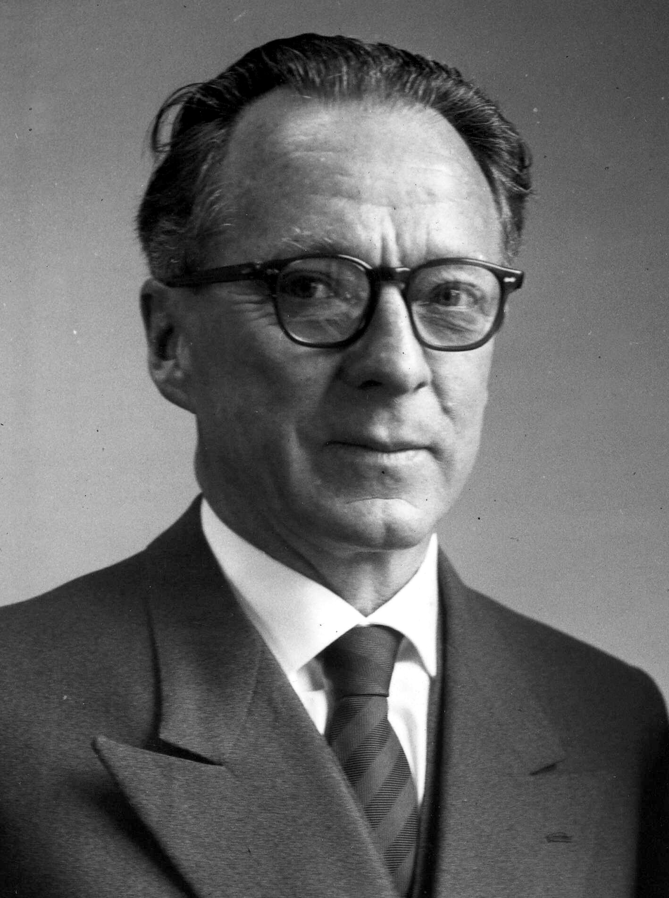
Defining Evaluation
Different authors have different notions of evaluation:
Perhaps the most extended definition of evaluation has been supplied by Clarence Edward Beeby (1977), who described evaluation as “the systematic collection and interpretation of evidence leading as a part of process to a judgement of value with a view to action.
(1902 – 1998)
was a New Zealand educationalist and psychologist.

Slide 10
Assessment and Evaluation: Differences
BASIS FOR COMPARISON | ASSESSMENT | EVALUATION
Meaning | Assessment is a process of collecting, reviewing and using data, for the purpose of improvement in the current performance. | Evaluation is described as an act of passing judgement on the basis of set of standards.
Nature | Diagnostic | Judgemental
What it does? | Provides feedback on performance and areas of improvement. | Determines the extent to which objectives are achieved.
Purpose | Formative | Summative

Slide 11
Assessment and Evaluation: Differences
BASIS FOR COMPARISON | ASSESSMENT | EVALUATION
Orientation | Process Oriented | Product Oriented
Feedback | Based on observation and positive & negative points. | Based on the level of quality as per set standard.
Relationship between parties | Reflective | Prescriptive
Criteria | Set by both the parties jointly. | Set by the evaluator.
Measurement Standards | Absolute | Comparative

Slide 12
Types of evaluation and their functions
Functionally evaluation is classified into four main types:
Formative evaluation
Summative evaluation
Placement evaluation
Diagnostic evaluation

Slide 13
Types of evaluation and their functions
determines the worth of the students’ performance, it is used to monitor learning progress during instruction, provide continuous feedback during the learning process.
Teacher made test and observational techniques are mostly used in generating data for the formative evaluation.
takes place at the end of instruction or programme. It is used to determine the extent to which the instructional goals have been achieved.
Evaluation done at the end of the term (first term examination) or a programme. It is mainly used for certification.
Formative evaluation
Summative evaluation

Slide 14
Types of evaluation and their functions
is used to evaluate students at the beginning of the instruction to determine students’ entry behaviour. Ukwuije (2007) stated that placement evaluation elicits the extent to which students’ interest, altitudes; habits will be suitable for their pursuance of a particular course of programme.
To answer these questions will require the use of variety of techniques such as records of past achievement, pretests on course objectives, self – report inventories and observational techniques and so on.
is done to determine the learning difficulties during instruction to formulate a plan for remedied action.
To carry out this evaluation, data are mostly elicited from diagnostic test as well as various observational techniques.
Placement evaluation
Diagnostic evaluation

Slide 15
Functions of evaluation
Placement function
Administrative function
Instructional function
Motivational function
Diagnostic function
Development function
Predictive function
Research function
Guidance function
Communicative function

Slide 16
Functions of evaluation
Study the entry behaviour of the child in all respect
· Help to undertake special instructional programmes
· Provide individualized instruction
· Help to select pupils for higher studies, for different vocations and specialized courses.
·Helps a teacher in deciding and developing ways, methods, and techniques of teaching.
· Helps to improve instruction and to plan appropriate and techniques of instructions.
· Helps in the improvement of curriculum and ssess different educational practices.
· Ascertains how far learning objectives can be achieved.
· Improve instructional procedures and quality of teachers.
· Plan appropriate and adequate learning strategies.
Placement function
Instructional function

Slide 17
Functions of evaluation
· Diagnose the weak points in the school programme as well as weakness of the students.
· Suggest relevant remedial programme.
· Diagnose the aptitude, interest, and intelligence of each child so that he may be energized towards a right direction.
· Adopt instruction to the different needs of the pupils.
· Evaluate the progress of these weak students in terms of their capacity, ability and goal.
· Discover potential abilities and aptitude among the learners.
· Predict the future success of the learner
· Helps the learner in selecting the right electives.
Diagnostic function
Predictive function

Slide 18
Functions of evaluation
· Helps to classify pupils in different convenient groups.
· Promote students to next higher class.
· Appraise the supervisory practices.
· Draw comparative statement on the performance of different children.
· Have sound planning.
· Helps to test the efficiency of the teachers in providing suitable learning experiences.
· Mobilize public opinion and to improve public relations.
· Help in developing a comprehensive criterion tests.
help both the teacher and the learner to:
· Assist a person in making decisions about course and careers.
· Enable the learner to know his pace of learning and lapses in his learning.
· Help the teacher to know the learner in details and to provide necessary educational, vocational, and personal guidance.
Administrative function
Guidance function

Slide 19
Functions of evaluation
· Motivate to direct, to inspire and to involve the students in learning.
· Award their learning and thus to motivate them towards study.
· It gives reinforcement and feedback to the teacher, students and the teaching learning processes.
· Assists in the modification and improvement of the teaching strategies and learning experiences.
· Help in the achievement of educational objectives and goals.
Motivational function
Development function

Slide 20
Functions of evaluation
· Helps to provide data for research generalization
· Evaluation clears the doubts for further studies and researches.
· Helps to promote action research in education.
· Communicate the result of progress to the students
· Intimate the results of progress to parents
· Circulate the results of progress to school.
Research function
Communicative function

Slide 21

The role of evaluation in teaching-learning process
Evaluation is concerned with assessing
the effectiveness of teaching,
teaching strategies,
methods and techniques.
It provides feedback to the teachers about their teaching and the learners about their learning.
Teaching

Slide 22

The role of evaluation in teaching-learning process
the improvement in
courses/curricula,
a text
and teaching material
is brought about with the help of evaluation.
Curriculum

Slide 23

The role of evaluation in teaching-learning process
evaluation provides accountability to society in terms of the demands and requirements of the employment market.
Society

Slide 24

The role of evaluation in teaching-learning process
evaluation mainly manifests itself in a perceived need for regular reporting to parents.
Parents

Slide 25
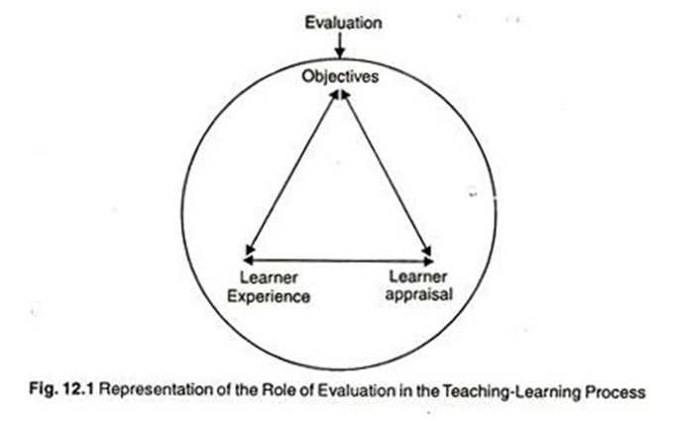
The role of evaluation in teaching-learning process

Slide 26

Principles of evaluation
Principle of continuity: - Evaluation is a continuous process, which goes on continuously as long as the student is related to education. Whatever the learner learn, it should be evaluated daily.
Principle of comprehensiveness: - By comprehensiveness we means to assess all aspects of the learner’s personality. It concerned with all-round development of the child.
Principle of Objectives: - Evaluation should be based on the objectives of education. It should be helpful in finding out where there is a need for redesigning and refraining the learner’s behavior.

Slide 27
Principles of evaluation
4) Principle of Learning Experience: – In this process, we don’t evaluate only the curricular activities of the learner but his co-curricular activities are also evaluated. Both types of activties are helpful in increasing learners experiences.
5) Principle of Broadness: – Evaluation should be broad enough to cover all the aspects of life.

Slide 28
Principles of evaluation
6) Principle of Child – Centeredness: - The behavior of the child is the central point for assessment. It helps a teacher to know the grasping power of a child and usefulness of teaching material.
7) Principle of Application: - During the teaching and learning process the child may learn many things, but it may not be useful in his daily life. He can’t apply it, then it is useless to find. It can be known through evaluation. Evaluation judges that student is better to apply his knowledge and understanding in different situations in order to succeed in life.

Slide 29

Self-evaluation as a system of evaluation
What is Self-Assessment?

Slide 30

Self-evaluation as a system of evaluation
What is Self-Assessment?
Brown and Harris (2013) defined self-assessment in the K-16 context as a “descriptive and evaluative act carried out by the student concerning his or her own work and academic abilities”.
Self-assessment is often (implicitly or otherwise) conceptualized as a personal, unguided reflection on performance for the purposes of generating an individually derived summary of one's own level of knowledge, skill, and understanding in a particular area.

Slide 31
Self-evaluation as a system of evaluation
Student self-assessment occurs when learners assess their own performance. With practice, they learn to:
1) objectively reflect on and critically evaluate their own progress and skill development
2) identify gaps in their understanding and capabilities
3) discern how to improve their performance
4) learn independently and think critically.
Use self-assessment to develop the learning skills students will need for professional competence, and to make them aware of and more responsible for their own learning processes.

Slide 32
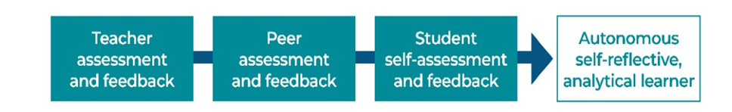
Self-evaluation as a system of evaluation
Sometimes teachers use self-assessment and peer assessment together. For example, they might require students to use a rubric to critique the work of their peers, and then to apply the same criteria to their own work.
Self-assessment can take many forms, for example, SWOT analysis or students can be given the marking scheme and asked to correct their own work. Students can also use reflecting journals, ‘I can’ statements, portfolios, etc.

Slide 33
Self-evaluation as a system of evaluation
Race (2001) suggests structuring the self-assessment by prompting students; for example, by asking them:
1) What do you think is a fair grade for the work you have handed in, and why do you think so?
2) What did you do best in this assessment task?
3) What did you do least well in this assessment task?
4) What did you find was the hardest part?
5) What was the most important thing you learned in doing this assessment task?
6) If you had more time to complete the task, what (if anything) would you change, and why?

Slide 34
Self-evaluation as a system of evaluation
Recommendations for the teachers on how to practice self-assessment in the classroom:
Provide opportunities for students to self-assess at all stages of the learning process.
Make self-assessment a regular part of what students do during and after learning.
Ensure students understand that self-assessment is about learning and improvement, not being right or wrong.
Explicitly teach, model and scaffold self-assessment.
Use a range of techniques and tools to enable students to gradually take increasing responsibility for their own learning and progress.
Teach students the language of self-assessment, such as evaluation, reflection, goal-setting and targets.

Slide 35
Self-evaluation as a system of evaluation
Self-assessment in the classroom:
1) Ask students to highlight the best section of their work and explain why they think it’s good.
2) Have students identify where they have met each of the success criteria.
3) Ask students to highlight the sentence/section of their work that they are most pleased with.
4) Ask students to write one question they would like you to answer in your feedback.
5) Include some reflection time at the end of the lesson. Teach students how to reflect on their learning.

Slide 36
Self-evaluation as a system of evaluation
Self-assessment in the classroom:
6) Pause during the lesson and ask students to discuss how their learning is going. Experiment with using Thumbs up or Traffic lights.
7) Provide some sentence starters and prompts to help students reflect and/or identify areas for improvement.
8) Teach and model self-assessment.
9) Provide exemplars so that students know what they’re aiming for.
10) Discuss and practice individual goal setting.
11) Ask students to identify an area where they are uncertain or where they think they need help to improve.

Slide 37
Self-evaluation as a system of evaluation
Self-assessment in the classroom:
12) Design some self-assessment templates.
13) Introduce Exit cards where students write and submit answers to prompts such as:
a. What was the most important thing you learned today?
b. What questions do you still have?<
c. Use 3,2,1 at the end of a lesson:
3 things I’ve learnt
2 questions I’ve got
1 insight I’ve had.

Slide 38
Self-evaluation as a system of evaluation
Sentence starters | Prompts
Today I learnt/Now I know… I now feel confident about … I felt confused when …/I’m having problems with… What I would most like to know is… I was pleased with… My teacher explained… I was unsure about…but now I … | What is one thing you learned? What was the most important thing you learned? What questions do you still have? What successes did you experience? What are the challenges you faced? What strategies helped you learn? What would you do differently next time?

Slide 39
European Language Portfolio about Evaluation
The European Language Portfolio is a personal document in which learners of all ages can record their language learning and cultural experiences both within and outside formal education. It also provides a framework for learners to assess their own language competences. The European Language Portfolio was developed by the Language Policy Division of the Council of Europe, piloted from 1998 to 2000, and launched in 2001, the European Year of Languages.
The ELP was conceived as a companion piece to the Common European Framework of Reference for Languages (CEFR; Council of Europe 2001). The CEFR is a descriptive apparatus that defines second and foreign language (L2) learning outcomes in terms of language use. It thus adopts an “action-oriented” approach which focuses on what learners can do in their L2(s)

Slide 40

European Language Portfolio about Evaluation
What is European Language Portfolio?
https://youtu.be/xA6_ZbppVOo

Slide 41
European Language Portfolio about Evaluation
What is the purpose of the European Language Portfolio (ELP)?
The ELP is designed to:
encourage the lifelong learning of languages, to any level of proficiency;
make the learning process more transparent and to develop the learner's ability to assess his/her own competence;
facilitate mobility within Europe by providing a clear profile of the owner's language skills;
contribute to mutual understanding within Europe by promoting plurilingualism (the ability to communicate in two or more languages) and intercultural learning.

Slide 42

European Language Portfolio about Evaluation
How is the European Language Portfolio (ELP) to be used?
Owners of all ages can use the ELP to:
keep a record of all their language learning, whether it takes place inside or outside the educational system;
develop their capacity to plan, monitor and evaluate their own learning;
record significant intercultural experiences;
collect evidence of their language skills;
document their language learning achievements.

Slide 43
European Language Portfolio about Evaluation
Language Portfolio (ELP) and the Council of Europe's common reference levels
The Common European Framework divides learners into three broad divisions which can be divided into six levels:
A Basic Speaker
A1 Breakthrough
A2 Waystage
B Independ Speaker
B1 Threshold
B2 Vantage
C Proficient Speaker
C1 Effective Operational Proficiency
C2 Mastery
The CEFR describes what a learner is supposed to be able to do in reading, listening, speaking and writing at each level.

Slide 44
European Language Portfolio about Evaluation
The ELP has three obligatory components:
summarises the owner’s linguistic identity and his or her experience of learning and using L2s.
It provides space for the owner periodically to record his or her self-assessment of overall L2 proficiency.
What language do you study?
What are your achievements?
What does your teacher think?
The language passport

Slide 45
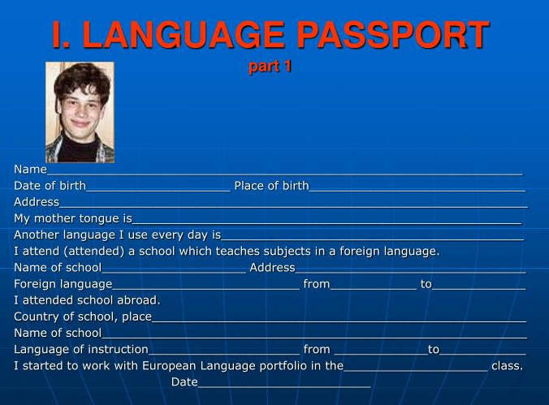

Slide 46


Slide 47
European Language Portfolio about Evaluation
The ELP has three obligatory components:
is used to set intermediate learning goals, review progress, and record significant language learning and intercultural experiences.
Checklists of communicative tasks in the form of “I can” descriptors are used to identify learning goals and assess learning outcomes. The descriptors are scaled according to the proficiency levels of the CEFR (A1, A2, B1, B2, C1, C2) and arranged by communicative activity (listening, reading, spoken interaction, spoken production, writing).
The language biography also supports reflection on learning styles, strategies and intercultural experience.
The language biography

Slide 48


Slide 49
European Language Portfolio about Evaluation
The ELP has three obligatory components:
It is where the owner collects evidence of his or her L2 proficiency and intercultural experience, and may also be used to store work in progress.
The dossier

Slide 50


Slide 51

European Language Portfolio about Evaluation
The ELP has two functions, pedagogical and reporting.
It is designed to support the language learning process in a variety of ways, but it also documents that process, providing a cumulative record of learning achievement and the owner’s experience of using the L2s he or she knows.

Slide 52
Conclusion
Evaluation is a continuous process and a periodic exercise. It plays an enormous role in the teaching – learning process. Evaluation has many functions - placement, instructional, diagnostic, predictive, guidance, motivational, development, research, communicative functions. Evaluation allows both teachers and learners to see the progress of learning and identify the ways how to improve teaching and learning.
There are also different types of evaluation – formative, summative, placement and diagnostic used for different purposes during teaching and learning.
Evaluation is not one-side process. Students can also practice self-evaluation. This allows the students to objectively approach to the analysis of the quality of their performance, identify the gaps, determine the stage of the development of their skills and set goals for further training, thus, promoting the development of critical thinking and learning autonomy.

Slide 53
Questions
1) What is evaluation?
2) What is the difference between evaluation and assessment? Are they the same thing?
3) How many types of evaluation are there?
4) What does each type of evaluation serve for?
5) What are the functions of evaluation? How many functions of evaluations are there?
6) What principles the teacher must follow while evaluation his or her students?
7) What is self-assessment?
8) Why does the teacher should practice self-evaluation or self-assessment with the students? What are the advantages of practicing self-evaluation? Are there any disadvantages?
9) How can students assess or evaluate themselves? What tools they use?
10) What questions does the student ask himself while self-assessment?
11) What is the European Language portfolio?
12) What are the obligatory components of the ELP?

Slide 54
References
1) Meidasari, V. E. The assessments and evaluation ion teaching English as a foreign language (https://www.researchgate.net/publication/320378982_THE_ASSESSMENT_AND_EVALUATION_IN_TEACHING_ENGLISH_AS_A_FOREIGN_LANGUAGE )
2) Malcova, P. The Role of Evaluation in Enhancing the Language Competences, Brno, 2006 (https://is.muni.cz/th/ula5m/The_role_of_evaluation_in_enhancing_the_language_competences.pdf)
3) Ifeoma, E. F. The Role of Evaluation in Teaching and Learning Process in Education, - International Journal of Advanced Academic and Educational Research, October, 2022 (https://arcnjournals.org/images/2726145223713511.pdf )
4) Dicha, M. Evaluation in Teaching and Learning Process | Education (https://www.yourarticlelibrary.com/statistics-2/evaluation-in-teaching-and-learning-process-education/92476 )
5) Surbhi S. Difference Between Assessment and Evaluation (https://keydifferences.com/difference-between-assessment-and-evaluation.html)
6) Новые технологии в образовании. Программа дополнительного профессионального образования для студентов выпускных курсов вузов, осуществляющих подготовку педагогических кадров, разработанная на основе уровневых повышения квалификации педагогических работников Республики Казахстан. Руководство для студента. - АОО «Назарбаев Интеллектуальные школы», 2015

Slide 55
References
7) Andrade, H.L. A Critical Review on Student Self-Assessment, Fron.Educ., - US, 2019 ( https://doi.org/10.3389/feduc.2019.00087 )
8) Tran T. H. Second Language Assessment for Classroom Teachers. – USA, 2012
9) Peer and Self-Assessment for students (https://education.nsw.gov.au/teaching-and-learning/professional-learning/teacher-quality-and-accreditation/strong-start-great-teachers/refining-practice/peer-and-self-assessment-for-students#tabs0 )
10) What is European Language Portfolio? (https://youtu.be/xA6_ZbppVOo)
11) Little D. The European Language Portfolio A guide to the planning, implementation and evaluation of whole-school projects. - Council of Europe, 2011 (https://www.ecml.at/Portals/1/documents/ECML-resources/2011_09_06_ELP-WSU_englisch_web.pdf )

